Slide 1

M&A INTEGRATION CHARTERS CHARTERS

Slide 2
Charter: Finance
Charter Statement:
Develop a high-level plan to integrate finance and administration without negatively impacting business operations while minimizing business risk.
Legal
Facilities (approve local decisions) A/P Investor Relations Credit
Accounting
Treasury A/R Financial Reporting
Team Scope
© 100-Day Advisors MandAPlaybook.com\
Key Questions:
How does our accounting treatment need to be revised?
What is our new close cycle and reporting package?
What should our credit policy be moving forward?
How should we manage contracts?
How do we maintain risk management continuity?
What is our plan for working capital and cash forecasting?
How do we consolidate our collections process?
How do we get our arms around A/P after the close?
© 100-Day Advisors MandAPlaybook.com
02
02

Slide 3
Charter: Human Resources
Charter Statement:
Develop a high-level plan to integrate people and development while minimizing impact on attrition and morale.
Compensation model/guidelines (non-sales)
Onboarding/approach for org decisions
Benefits Payroll Training
Recruiting Employment Agreements Employment Policies/Employee Handbook
Team Scope
Key Questions:
How do we transition the Acquiree Stock Plan?
What is the transition plan for 401(k)?
How do we manage leadership development? Sales training?
How should we reconcile the compensation structure for non-sales employees?
How do we manage recruiting and new employee orientation?
© 100-Day Advisors MandAPlaybook.com
03
02

Slide 4
Charter: IT / Systems
Charter Statement:
Develop a high-level plan to integrate information systems without negatively impacting business operations.
Networks
Telecom Core Business Systems Development End User Training
Help Desk / Support
Web Sites / E-Commerce Hosting / Data Centers Disaster Recovery
Team Scope
Key Questions:
What is the plan to move payroll onto Acquirer systems?
How will we move all of our business applications to SAP?
What is the plan to re-train end users?
How will we transition desktop and infrastructure support?
How will we manage time tracking and performance management?
© 100-Day Advisors MandAPlaybook.com
04
02

Slide 5
Charter: Marketing / Communications
Charter Statement:
Develop a high-level plan to integrate marketing and communications functions without negatively impacting our public perception or marketing results.
Public Relations
Employee Communications Branding Advertising
Events
Partner Marketing Sales Collateral
Team Scope
Key Questions:
How do we communicate the changes to all interested parties?
What is our branding and messaging strategy going forward?
How do we manage in-flight marketing efforts?
What communications do we need to support the sales force?
How do we manage our partner marketing agreements?
© 100-Day Advisors MandAPlaybook.com
05
02

Slide 6
Charter: Alliance Partnerships
Charter Statement:
Develop a high-level plan to integrate partnerships and alliances without negatively impacting our valuable strategic relationships.
Strategic Alliances
Marketing Partnerships Business Development
Team Scope
Key Questions:
How do we manage potential conflicts of interest?
How to we leverage our relationships to get more synergy from the deal?
What new opportunities does the deal present to us and how should we pursue them?
© 100-Day Advisors MandAPlaybook.com
06
02

Slide 7
Charter: Sales and Customer Service
Charter Statement:
Develop a high-level plan to integrate sales and customer service without negatively impacting revenue and customer satisfaction.
Sales Model
Pricing Strategy
Sales Compensation Sales / Service Org Structure Planning / Forecasting
Sales Operations Sales Support Customer Service
Team Scope
Key Questions:
What is the right sales model for each product line/offering? For each customer segment?
What is the right compensation model?
What are the reporting relationships?
How do we consolidate operations and customer support?
What is the process for setting targets and forecasting results?
© 100-Day Advisors MandAPlaybook.com
07
02

Slide 8
Charter: North America and APAC
Team Scope
All aspects of the integration as it relates to North America and Asia Pacific
Project driver on prioritized geographic initiatives
  Alliance Partner Strategy
Coverage Model
Client Engagement/Opportunity Desk
Pricing Strategy
Client Solutions business Model
Partner/Publisher Engagement
Contract Alignment
Operational Processes
Public Sector Company Alignment
  APAC
  Management Systems
Global plan support and geographic implementation
Contract alignment of people and processes
Drive Development of plan to introduce hardware into the APAC region
Key Questions:
Detailed integration plan for integrating Acquiree into the Acquirer for North America and Asia Pacific
Scope documents for each of the key projects
Weekly updates to the Functional Executive team
Communications weekly on progress and input to integration newsletters
Drive recommendations and escalations for activities tied to the overall geographic plans
© 100-Day Advisors MandAPlaybook.com
08
02

Slide 9
Charter: United Kingdom and EMEA
Charter Statement:
Build a template in the UK for the new EMEA country business model that creates a total IT solutions partner for our mid-market, enterprise, public sector and global clients, partners and employees.
Align the EMEA organization with the values & functional structures, policies & procedures of Acquirer
Create a single EMEA organization
Leverage the new global and capability value proposition to differentiate against our competitors
Team scope
UK /EMEA elements of the vertical functional plans
Sales organization and Client Operations organizations
Sales systems and processes for volume licensing sales and services
Alignment of sales forecasting
Mid-market strategy and execution for EMEA
Go-to-market plan for Software and Software Services
Increase vendor marketing activity and income
Consistent client approach for global software business
Procurement Strategy
Hardware: Development of capabilities to sell hardware in the EMEA territories
Identification of quick wins
© 100-Day Advisors MandAPlaybook.com
09
02

Slide 10
Charter: United Kingdom and EMEA (cont.)
Deliverables:
Maintain client satisfaction and focus
Leverage complimentary opportunities within the UK
Form sub-teams and begin ‘discovery’
Purchase price & process alignment
Reforecast Q4 and make quick decisions to guarantee EPS
Identify ‘quick-wins’
Complete organization structure revisions
Implement Acquirer metrics and management system for UK Software Team
© 100-Day Advisors MandAPlaybook.com
10
02

Slide 11
Charter: Global Client Operations
Charter Statement:
Global Client Operations will develop strategies and roadmaps for creating the ultimate client experience globally for the short-term integration in line with long term end state.
We will take ownership of understanding clients’ needs and deliver consistent tools, processes and organizational structures in order to expand the global reach of Acquirer (hardware, software and services). Our employees’ focus will be designing the best experience at every client touch point thereby gaining a differentiated market position.
Team Scope:
Client Experience Offerings
Software Transaction Model
Operational Processes & Tool Alignment
Client Support Model (consistent job responsibilities globally for client support)
Data (client, parts, contracts, partner)
Consolidated Reporting (client/partner)
Client Pricing Policies
Procurement
Costing
Business Process Outsourcing for Functional Areas
11
© 100-Day Advisors MandAPlaybook.com
02

Slide 12
Charter: Global Client Operations (cont.)
Deliverables:
Determine Software Transaction Model (clients, parts, licensing contracts, cost model, pricing)
Software Client Support Model
Client Impact Analysis of Offerings. Research and documentation of all client impacting processes and offerings globally, highlighting consistencies and inconsistencies with plans to resolve as necessary.
Client support desk (a place to send questions/requests until our offerings are solidly merged)
Invoicing strategy aligned with client requirements
Strategy and process for consolidated global reporting (client/partner)
Documentation of all current responsibilities into functional org charts and clear transition plan for moving any between groups or any being discontinued (i.e. procurement)
Current assessment of BPO activities and short-term leverage and changes as necessary
© 100-Day Advisors MandAPlaybook.com
12
02

Slide 13
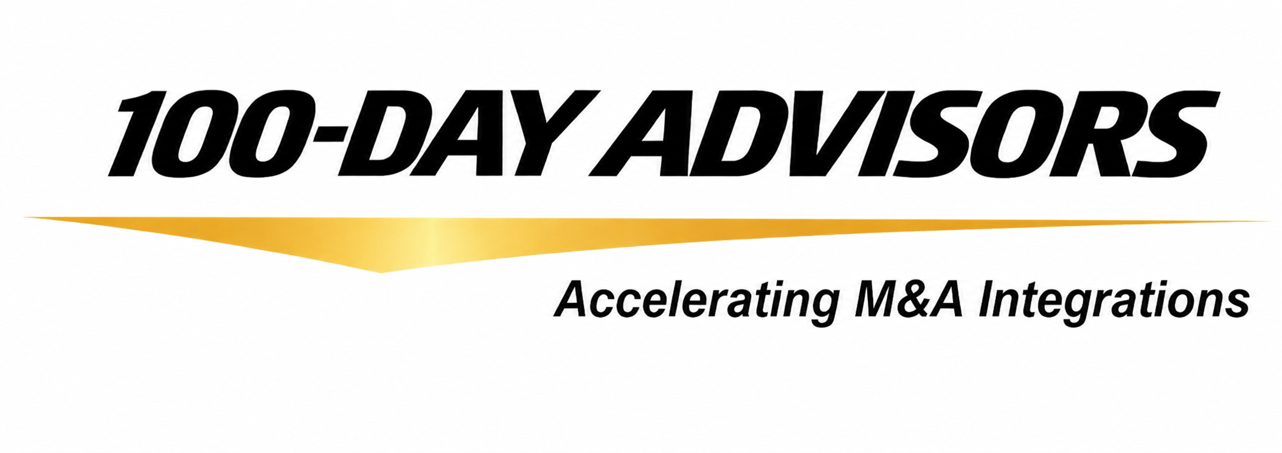


Contact us
Email: inquiries@ MandAPlaybook.com
Website: MandAPlaybook.com
© 100-Day Advisors MandAPlaybook.com
10
02

